Slide 1
NYPD Shooting Incidents, Seasonality, and Time of Day
Presented by J. Kolb
For Data Science as a Field
University of Colorado Boulder

Slide 2
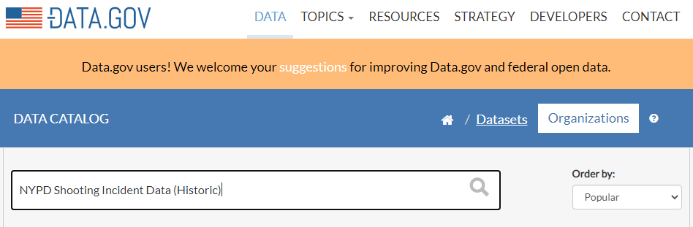
Importing Data
https://catalog.data.gov/dataset

Slide 3
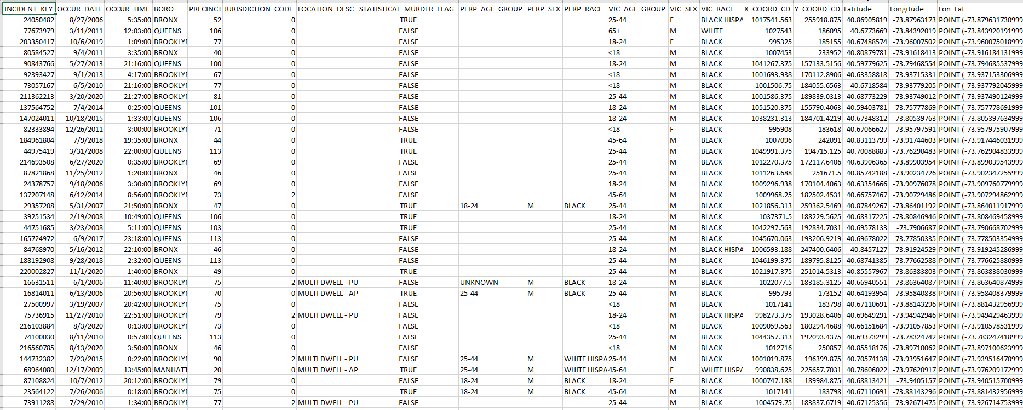
NYPD Shooting Incidents (Historic)

Slide 4
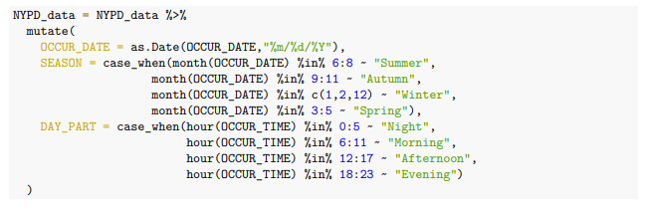
Tidying Data

Slide 5
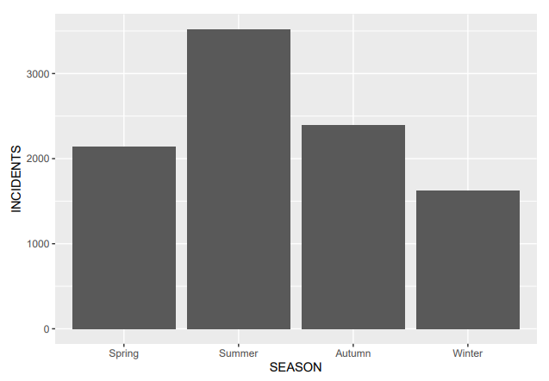
Incidents by Season

Slide 6
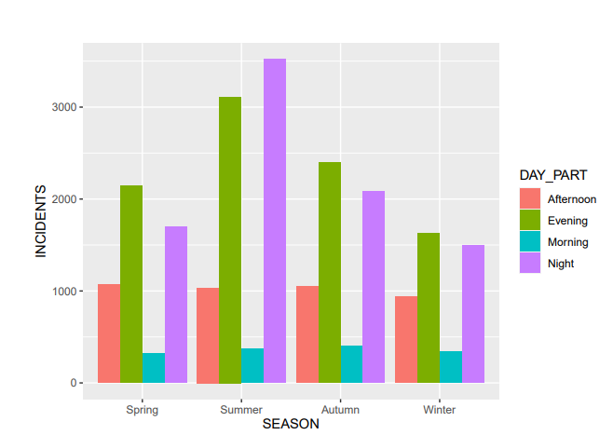
Incidents by Time Of Day

Slide 7

chisq.test(Incidents)
Pearson’s Chi-squared test - We compare the actual results against what we’d expect if the two categories were independent.
Null Hypothesis: Season and Time of Day are independent, observed distribution occurred by chance.
Based on the test statistic, we reject the null hypothesis. With a Chi-squared result of 372 and 9 degrees of freedom, the p-value is <0.00000000000000022 – effectively zero.

Slide 8
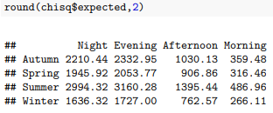
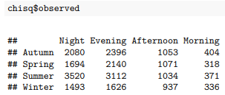
Expected vs. Observed

Slide 9
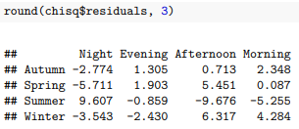
Residuals
We can calculate the residuals to quantify the contribution of each cell to the Chi-squared score.
A larger positive or negative value indicates a larger positive or negative correlation.
Large Positive Correlation: Summer and Nights, Winters and Afternoons, and Springs and Afternoons
Large Negative Correlations: Summer and Afternoons, Summers and Mornings, Springs and Nights

Slide 10
Conclusion
“Based on our analysis, we can conclude that season and time of day are not independent categories. We can identify several strong positive and negative correlations. Finally, we can recommend several shifts of shooting prevention resources based on the time of year and time of day.”

Slide 11
Bias and Other Issues
Data is collected by New York Police Department
I am uncomfortable trusting the demographic data collected by the NYPD
Meteorological seasons are only an approximation
Precipitation should be considered
Academic calendars and holidays should be considered
6-hour day parts could obscure important details

Slide 12
Thank You!

